Slide 1

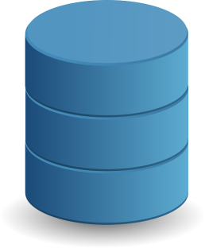
Serialization in Java
Serialization in java is a mechanism of writing the state of an object into a byte stream.
It is mainly used in Hibernate, RMI, JPA, EJB, JMS technologies.
The reverse operation of serialization is called deserialization.
Object
DB
Stream Of bytes
Memory

Slide 2
Serialization in Java
Uses for Serialization
Serialization is used in many scenarios, but the main purpose is to save the state of an object in order to have the ability to recreate the same object when required. It is an important to let the user save work and then be able to continue from that point at a later time. This is a common need in various tools and applications. Serialization is also used in creating a clone of an object.
Another important need for serialization arises when the object is required to travel electronically over wire. In such cases the objects are serialized and deserialized.

